Slide 1
Design patterns

Slide 2
What are Design Patterns
Design patterns are solutions to software design problems we find again and again in real-world application development.
Patterns are about reusable designs and interactions of objects.
A design pattern isn't a finished design that can be transformed directly into code.
It is a description or template for how to solve a problem that can be used in many different situations.

Slide 3
Where do they come from
Design patterns have their roots in the work of Christopher Alexander, a civil engineer.
About 20 years ago, software professionals began to incorporate Alexander's principles into the creation of early design pattern documentation as a guide to novice developers.
Design Patterns: Elements of Reusable Object-Oriented Software in 1995 by Eric Gamma, Richard Helm, Ralph Johnson, and John Vlissides.

Slide 4
Benefits of Design patterns
They are language neutral and so can be applied to any language that supports object-orientation
They aid communication by the very fact that they are well documented and can be researched if that is not the case.
They have a proven track record as they are already widely used and thus reduce the technical risk to the project
They are highly flexible and can be used in practically any type of application or domain

Slide 5
Two main principles
Always prefer composition over inheritance
Whenever you code, code for interface not for implementation

Slide 6
Categories of design patterns
Creational
Structural
Behavioral

Slide 7
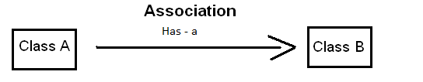
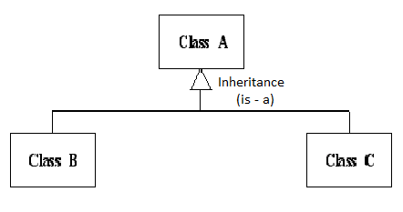
UML notations

Slide 8

Factory Pattern

Slide 9
Simple Factory
Strictly speaking, it's not a design pattern, but a technique we use very often.
Intent: It encapsulates the object instantiation process.

Slide 10
Motivation
Calling “new” is certainly coding to an implementation
In fact, it’s always related to a concrete class
That’s fine when things are simple, but…
When you have several related classes, that’s probably a good sign that they might change in the future

Slide 11
This is programming to implementation instead of interface.
Concrete classes are instantiated in more than one place.
Thus, when changes or extensions are made all the instantiations will have to be changed. Such extensions can result in updates being more difficult and error-prone.

Slide 12
Client
Expense
+ Choose Expense(): Expense
+getExpense():decimal
Travel
OnDemand
Food
+getExpense():decimal
+getExpense():decimal
+getExpense():decimal

Slide 13
Client
Simple Factory
Expense
+ Choose Expense(): Expense
+ Choose Expense(): Expense
+getExpense():decimal
Travel
OnDemand
Food
+getExpense():decimal
+getExpense():decimal
+getExpense():decimal

Slide 14
Pull the code that builds the instances out and put it into a separate class
Why do we need this
Multiple clients needing same types of object
Ensure consistent object initialization

Slide 15
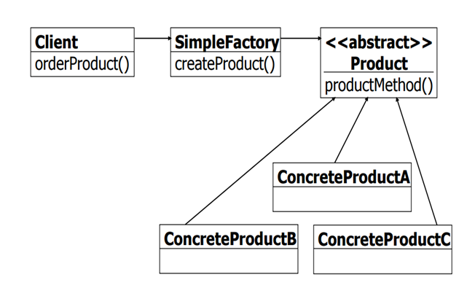

Slide 16
Factory Method Pattern
Intent: Defines an interface for creating an object, but let's the Subclasses that implement the interface decide which class to instantiate.
The Factory method lets a class defer instantiation to subclasses.

Slide 17
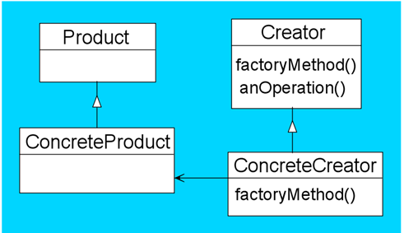
Class diagram

Slide 18
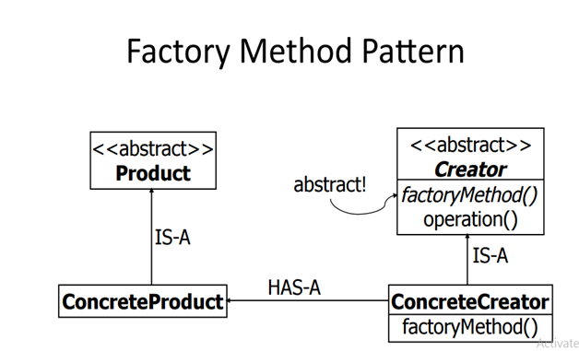

Slide 19
Applicability
Use Factory Method when A class can’t anticipate the class of objects it must create.
A class wants its subclasses to specify the objects it creates

Slide 20
Guidelines
- If the classes doesn't extend common base class or interface they can not be used in a factory design template.

Slide 21
Abstract Factory
Intent:
Provide an interface for creating families of related or dependent objects without specifying their concrete classes.
The new operator considered harmful.
Motivation: Abstract Factory Pattern says that just define an interface or abstract class for creating families of related (or dependent) objects but without specifying their concrete subclasses.That means Abstract Factory lets a class returns a factory of classes. So, this is the reason that Abstract Factory Pattern is one level higher than the Factory Pattern.
An Abstract Factory Pattern is also known as Kit.

Slide 22
Explanation:
The abstract factory class defines the abstract methods that have to be implemented by concrete factory classes.
The concrete factory classes contain the real implementation that define which classes are created during run-time.

Slide 23
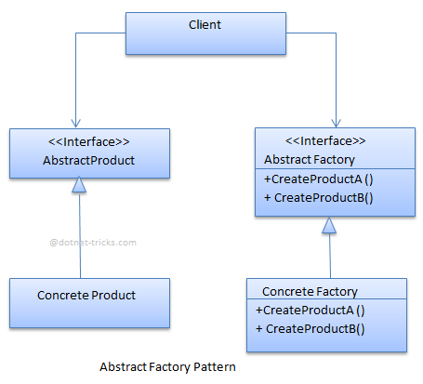
UML Diagram

Slide 24
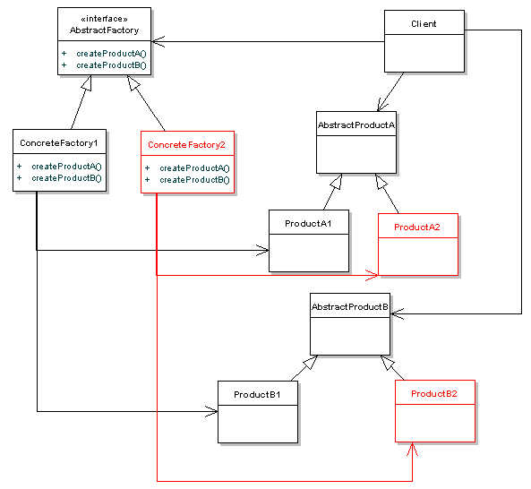
Class Diagram

Slide 25
Example
→ IComputer (Interface)
→ Lenovo,Hp,Dell (Families)
→ IRam, ICpu, IHardDisk (Related objects)

Slide 26
When to use it?
Create a set of related objects, or dependent objects which must be used together.
System should be configured to work with multiple families of products.
The creation of objects should be independent from the utilizing system.
Concrete classes should be decoupled from clients.
you want to provide a class library of products, and you want to reveal just their interfaces, not their implementations.

Slide 27
Strategy pattern
Strategy design pattern is one of the behavioral design pattern.
Intent:
Define a family of algorithms, encapsulate each one, and make them interchangeable. Strategy lets the algorithm vary independently from clients that use it.
Strategy pattern is useful when we have multiple algorithms for specific task and we want our application to be flexible to chose any of the algorithm at runtime for specific task.
The strategy pattern is one way that composition can be used as an alternative to subclassing.

Slide 28
Motivation
There are common situations when classes differ only in their behavior. For this cases is a good idea to isolate the algorithms in separate classes in order to have the ability to select different algorithms at runtime.
Strategy pattern is also known as Policy Pattern

Slide 29
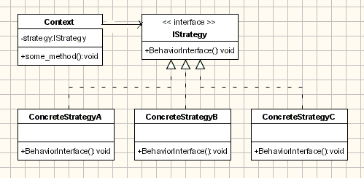
Class diagram

Slide 30
Participants
The classes participating in this pattern are:
Strategy
declares an interface common to all supported algorithms. Context uses this interface to call the algorithm defined by a ConcreteStrategy
ConcreteStrategy
implements the algorithm using the Strategy interface
Context
is configured with a ConcreteStrategy object
maintains a reference to a Strategy object
may define an interface that lets Strategy access its data.

Slide 31
Examples:
compressing files
Storing Data

Slide 32
Template Pattern
Template design pattern is one of the behavioral design pattern.
Intent:
Define the skeleton of an algorithm in an operation, deferring some steps to subclasses.
Template Method lets subclasses redefine certain steps of an algorithm without changing the algorithm's structure.

Slide 33
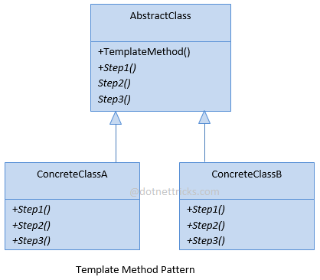
Class Diagram

Slide 34
Participants
Abstract Class
This is an abstract class that contains template method and abstract operations for each of the steps that may be implemented by subclasses.
This class mainly contain 2 type of methods. First it contain methods for each step of the algorithm. Second method in this class is the Template method. Template method is the method which used all the individual methods and provides a skeleton for execution of the algorithm.
Concrete Class A/B
These are subclasses which inherits the Abstract Class and override the abstract class operations.
This class contain override the methods Abstract class provides for each step of algorithm.
They contain the custom implementation of these steps step. This class will contain the default implementation of these steps.

Slide 35
Example
Abstract Class with Template Method
abstract class DataExporter { // This will not vary as the data is read from sql only public void ReadData() { Console.WriteLine("Reading the data from SqlServer"); } // This will not vary as the format of report is fixed. public void FormatData() { Console.WriteLine("Formating the data as per requriements."); } // This may vary based on target file type choosen public abstract void ExportData(); // This is the template method that the client will use. public void ExportFormatedData() { this.ReadData(); this.FormatData(); this.ExportData(); } }

Slide 36
class ExcelExporter : DataExporter { public override void ExportData() { Console.WriteLine("Exporting the data to an Excel file."); } }
class PDFExporter : DataExporter { public override void ExportData() { Console.WriteLine("Exporting the data to a PDF file."); } }
static void Main(string[] args) { DataExporter exporter = null; // Lets export the data to Excel file exporter = new ExcelExporter(); exporter.ExportFormatedData(); Console.WriteLine(); // Lets export the data to PDF file exporter = new PDFExporter(); exporter.ExportFormatedData(); }

Slide 37
Usage:
When you are certain about the High Level steps involved in an Algorithm/Work flow you can use the Template Pattern which allows the Base Class to define the Sequence of the Steps but permits the Sub classes to alter the implementation of any/all steps.

Slide 38
Why design patterns
Types of Design Patterns
Design Patterns that we discussed

Slide 40
Abstract Factory Class Diagram

Slide 41
Strategy pattern Class diagram

Slide 42
Template pattern Class Diagram

Slide 43
Scenario 1
We have touch cooler Where we have 3 buttons
Cool
Swing
Cool+Swing
On clicking each has to do its own function

Slide 44
Scenario 2
We have UI containing rectangle, square, circle etc., On clicking any button, corresponding shape has to be drawn.

Slide 45
Scenario 3
Database Manager that supports multiple database operations(Sql server, Oracle etc..)

Slide 46
Scenario 4
vending machine which prepares Tea coffee

Slide 47
Structural Design pattern
Motiv : Program to an interface, not an implementation.
These design patterns deal with class and object composition. The concept of inheritance is used to compose interfaces and define ways to compose objects to obtain new functionality.

Slide 48
Decorator Pattern
Decorator design pattern is one of the Structural design pattern.
Intent:
Attach additional responsibilities to an object dynamically. Decorators provide a flexible alternative to subclassing for extending functionality
Decorator pattern is used to add new functionality to an existing object without changing its structure.
This pattern creates a decorator class which wraps the original class and add new behaviors/operations to an object at run-time.

Slide 49
Participants
Component:
Defines the interface for objects that can have responsibilities added to them dynamically.
Concrete Component:
Defines an object to which additional responsibilities can be attached.
Decorator:
Maintains a reference to a Component object and defines an interface that conforms to Component's interface.
Concrete Decorator:
Adds responsibilities to the component.

Slide 50
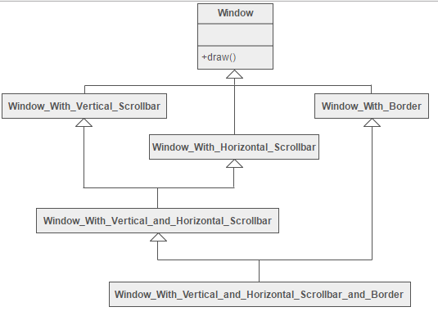
Scenario

Slide 51
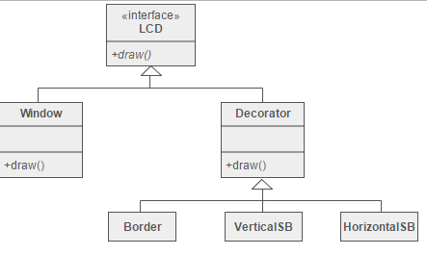
Solution

Slide 52
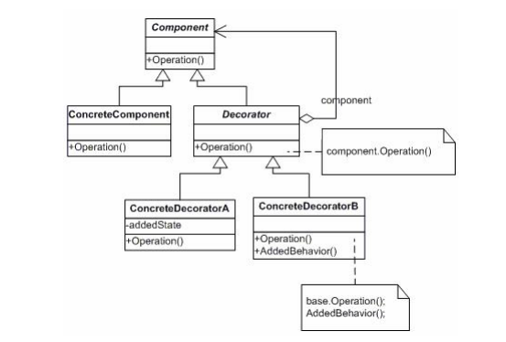
UML Diagram

Slide 53
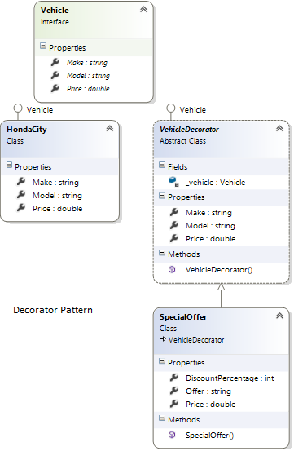
Example
Notes:
Who is what?
The classes, interfaces and objects in the above class diagram can be identified as follows:
Vehicle - Component Interface.
HondaCity- ConcreteComponent class.
VehicleDecorator- Decorator Class.
Special Offer- ConcreteDecorator class.

Slide 54
Examples
Various Types of Pizza

Slide 55
When to use it?
Add additional state or behavior to an object dynamically
To add responsibilities to individual objects dynamically and transparently, that is, without affecting other objects.
For responsibilities that can be withdrawn.

Slide 56
Composite design pattern
Intent
Compose objects into tree structures to represent part-whole hierarchies. Composite lets clients treat
individual objects and compositions of objects uniformly.

Slide 57
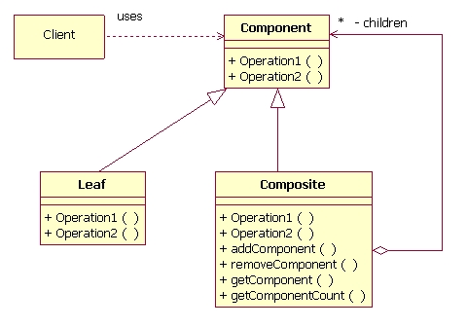
class diagram

Slide 58
Participants
Component
declares interface for objects in composition.
implements default behaviour for the interface common to all classes as appropriate.
declares an interface for accessing and managing its child components.
Leaf
represents leaf objects in the composition.A leaf has no children.
defines behaviour for primitive objects in the composition.
Composite
defines behaviour for components having children.
stores child components.
implements child related operations in the component interface.
Client
manipulates objects in the composition through the component interface.

Slide 59
When to use it
you want to represent part-whole hierarchies of objects.
you want client to be able to ignore difference between compositions of objects and individual objects.Clients will treat all objects in the composite structure uniformly.

Slide 60
Examples
Organization employee chart
Drawing
Calculating component cost

Slide 61
Chain of responsibility
Intent:
Avoid coupling the sender of a request to its receiver by giving more than one object a chance to handle the request.
Chain the receiving objects and pass the request along the chain until an object handles it.

Slide 62
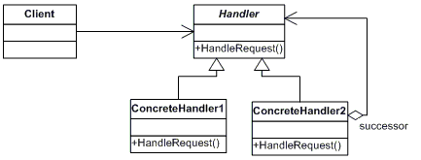
Class diagram

Slide 63
Participants
The classes and objects participating in this pattern are:
Handler defines an interface for handling the requests
(optional) implements the successor link
ConcreteHandler handles requests it is responsible for
can access its successor
if the ConcreteHandler can handle the request, it does so; otherwise it forwards the request to its successor
Client initiates the request to a ConcreteHandler object on the chain

Slide 64
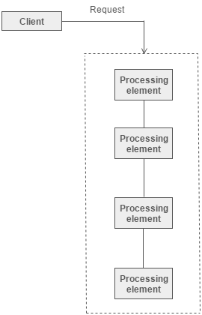

Slide 65
Important Points
Client doesn’t know which part of the chain will be processing the request and it will send the request to the first object in the chain.
Each object in the chain will have it’s own implementation to process the request, either full or partial or to send it to the next object in the chain.
Every object in the chain should have reference to the next object in chain to forward the request.
Creating the chain carefully is very important otherwise there might be a case that the request will never be forwarded to a particular processor or there are no objects in the chain who are able to handle the request.This is a design decision.
Chain of Responsibility design pattern is good to achieve loose coupling but it comes with the tradeoff of having a lot of implementation classes and maintenance problems if most of the code is common in all the implementations.

Slide 66
Adapter design pattern
Adapter design pattern is one of the Structural design pattern.
It's used to identifying a simple way to realize relationships between entities.
Intent
Convert the interface of a class into another interface clients expect. Adapter lets classes work together that couldn't otherwise because of incompatible interfaces.

Slide 67
Participants
Target:
Defines the domain specific interface that Client uses.
Adapter:
Adapts the interface Adapter to Target interface.
Adaptee :
Defines the an existing interface that needs adapting
Client :
Collaborates with the objects conforming to the Target interface.

Slide 68
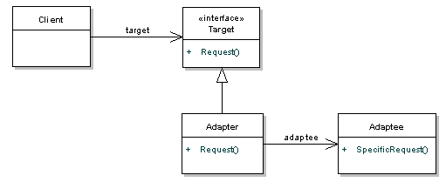
Class Diagram

Slide 69
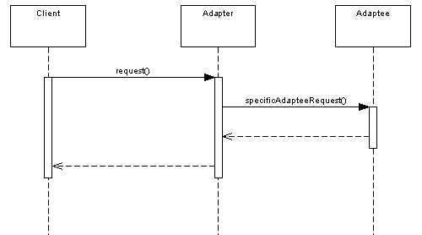
Sequence Diagram

Slide 70
Thank You...

